Slide 1

What do we know about the UK Covid-19 Inquiry so far?
Alex Friston and Hannah Frost

Slide 2
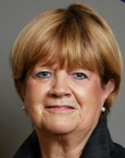
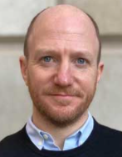
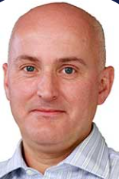
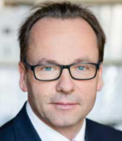
WHAT DO WE KNOW ABOUT THE UK COVID-19 INQUIRY SO FAR?
Inquiry Chair
Dame Heather Hallett
Director of Inquiry Set-Up
Ben Connah
Solicitor to the Inquiry
Martin Smith
Counsel to the Inquiry
Hugo Keith QC

Slide 3
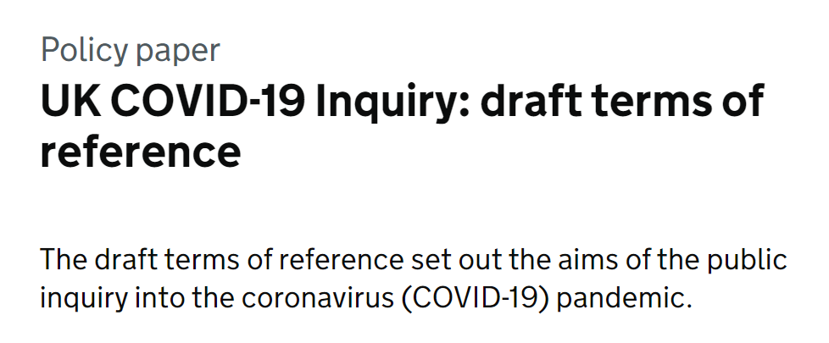
WHAT DO WE KNOW ABOUT THE UK COVID-19 INQUIRY SO FAR?

Slide 4

Public Consultation
WHAT DO WE KNOW ABOUT THE UK COVID-19 INQUIRY SO FAR?
The Chair of the UK Covid-19 Inquiry has invited views on the draft terms of reference.
The consultation ends on 7 April 2022.

Slide 5

Predicted Timescales and Structure of the UK Covid 19 Inquiry
WHAT DO WE KNOW ABOUT THE UK COVID-19 INQUIRY SO FAR?

